Slide 1
Mapping HealthCare Center
Presenter:
Mr. Menglim SMAE
Mr. Saovorak KHOY
Royal University of Phnom Penh

Slide 2
Content
Introduction
Background
Why this tool?
Scenario
Features
Future Work
Demo Application

Slide 3
Introduction
Conducted by IT Center, Royal University of Phnom Penh
Under the grant of Google.org
Tool to provide HealthCare information such as number of beds, number of doctors….
Integrated with Google Map/ Earth

Slide 4
Background
Population: 14.8 million, 2012
Population in Phnom Penh: 1.5 million
Number of National Hospital: 7
Referral Hospital: 5, each district have one referral hospital
Healthcare: 17
Others are clinics
Notes:
Calmette Hospital
Kantha Bopha Hospital (KBH)
Jayavarmann VII Hospital
Kantha Bopha I Hospital
Kantha Bopha II Hospital
Kantha Bopha IV Hospital
Kantha Bopha V Hospital
National Maternal and Child Health Centre (NMCHC)
National Pediatric Hospital (NPH)
PADH
Khmer-Soviet Friendship Hospital (KSFH)
PKSMH
National Center for Tuberculosis and Leprosy Control (CENAT)

Slide 5
Background
Almost 50% of Cambodian people in the City are using Internet via Computer and Mobile phone.
Especially, young generation using Mobile phone.
http://en.wikipedia.org/wiki/Telecommunications_in_Cambodia (2012)
Notes:
Calmette Hospital
Kantha Bopha Hospital (KBH)
Jayavarmann VII Hospital
Kantha Bopha I Hospital
Kantha Bopha II Hospital
Kantha Bopha IV Hospital
Kantha Bopha V Hospital
National Maternal and Child Health Centre (NMCHC)
National Pediatric Hospital (NPH)
PADH
Khmer-Soviet Friendship Hospital (KSFH)
PKSMH
National Center for Tuberculosis and Leprosy Control (CENAT)

Slide 6
Why this tools?
Encourage Cambodian people to use IT to access nearest hospital
Develop database for storing the information for public use
To visualize the healthcare, provide its information and identify the shortest route
Easy to find healthcare information via IT technology

Slide 7
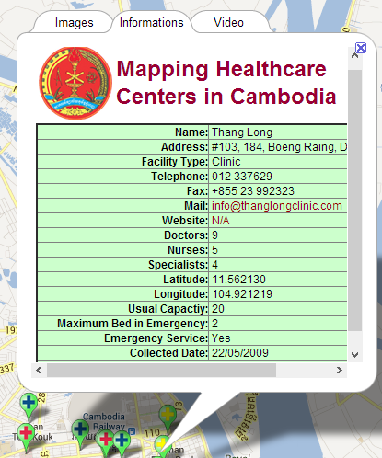
Scenario
http://rupp.edu.kh/googleproject/

Slide 8
Features
User Management
User can register & Sign in
Ability to add & Update healthcare information into map
Anonymous user, Registered User, and Administrator
Healthcare management
Display healthcare on Google map
Find healthcare information

Slide 9
Future work
Promoted and train the related sector to use the system
Healthcare center plotted only in Phnom Penh area. Will be covered in country
Some additional information was not able to be obtained due to privacy issue.
Dynamic update information via web and mobile phone

Slide 10
Demo application
Demo application
Notes:
To give you all a glace on what we are doing, please imagine this situation
There is a man who are suddenly fell down because of his blood pressure, then his family member are trying to look for medical center in which correspond to his sickness. In most the developing country where most of people has low background then they would just bring him to where the hospital is. What if, the hospital do not have the enough capacity or equipment? And what if they do not have doctor who are specialize in that field?
Here are the case where MappingHealth Care System can all answer to them!! Please work through this scenario with us!

Slide 11
Thank You for Your Attention!

